Slide 1

Exploring the limits of transfer learning with a unified text-to-text transformer
Machine learning for NLP SS-2020
Saarland University
Lakshmi Bashyam
1
Notes:
<number>

Slide 2
Outline
  Architecture
  C4 corpus
  Comparison study
The paper presents
T5 model architecture
  Based on transformer architecture proposed in the paper “Attention is all you need” by Vaswani et al., 2017
Colossal Clean Crawled Corpus (C4)
Study of Transfer Learning Methodology
1
Notes:
<number>

Slide 3
Outline
  Architecture
  C4 corpus
  Comparison study
Traditional ML
Dataset A
Model A
Output
Dataset B
Model B
Output
2

Slide 4
Outline
  Architecture
  C4 corpus
  Comparison study
Transfer learning
Dataset A
Model A
Dataset B
Model B
Knowledge
Output
2

Slide 5
Baseline Model Architecture
Transformer and T5 baseline architecture
2

Slide 6
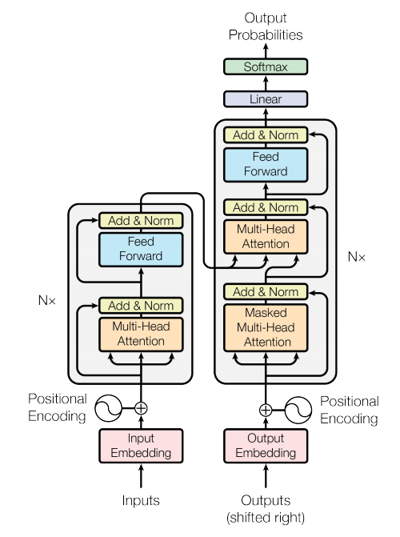
Outline
  Architecture
    Transformer
    BERT
    T5
  C4 corpus
  Comparison study
Transformer
Attention
Multi head attention
Masked multi head attention
[Attention is all you need by Vaswani et al]
2

Slide 7
Outline
  Architecture
    Transformer
    BERT
    T5
  C4 corpus
  Comparison study
Transformer
Input embedding
Positional embedding
Layer normalization
2

Slide 8
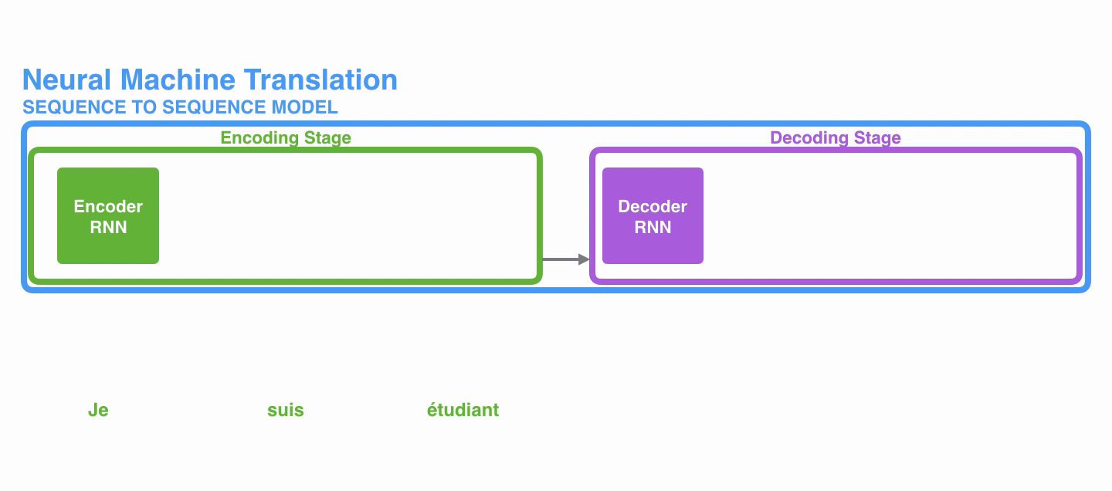
Outline
  Architecture
    Transformer
      Attention
      Multi-head attn
      Masked attn
    BERT
    T5
  C4 corpus
  Comparison study
Sequence-to-Sequence model
Problem:
  Context vector cannot capture all the information in long sentences.
  Vanishing gradient
2
[Visualizing a neural translation model : https://jalammar.github.io/visualizing-neural-machine-translation-mechanics-of-seq2seq-models-with-attention/]

Slide 9
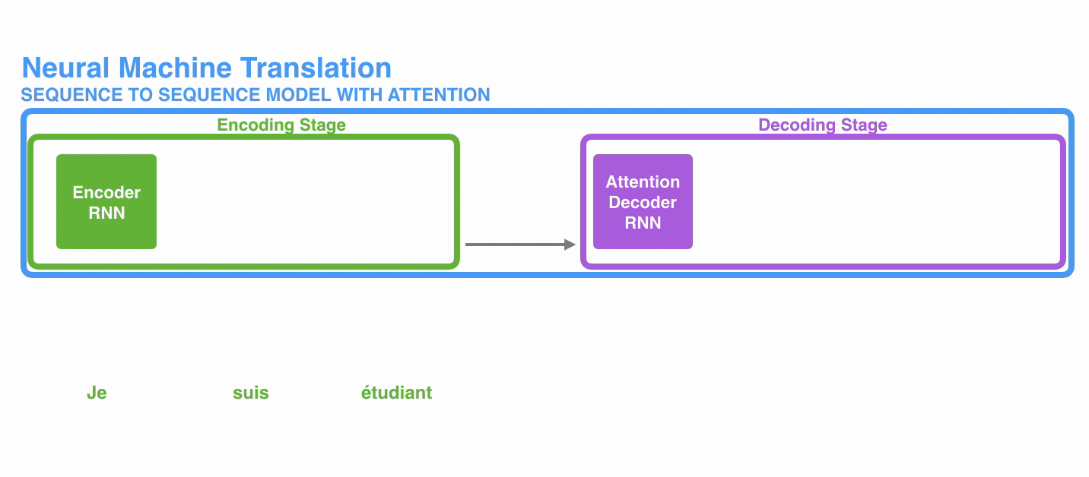
Outline
  Architecture
    Transformer
      Attention
      Multi-head attn
      Masked attn
    BERT
    T5
  C4 corpus
  Comparison study
Attention
  Weighs each term of sequence by focusing on relevant part of the sequence.
2
[Visualizing a neural translation model : https://jalammar.github.io/visualizing-neural-machine-translation-mechanics-of-seq2seq-models-with-attention/]

Slide 10
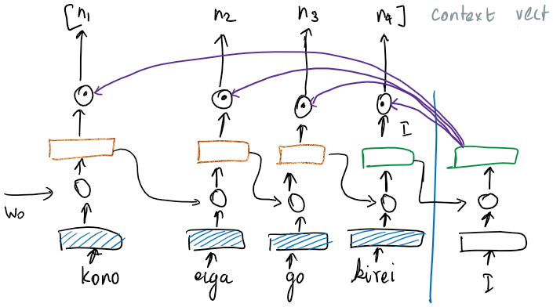
Outline
  Architecture
    Transformer
      Attention
      Multi-head attn
      Masked attn
    BERT
    T5
  C4 corpus
  Comparison study
Attention
  Weighs each term of sequence by focusing on relevant part of the sequence.
2

Slide 11
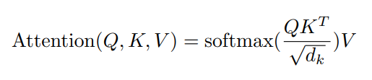
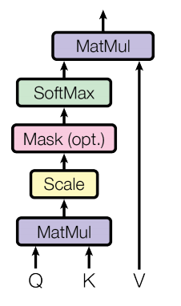
Outline
  Architecture
    Transformer
      Attention
      Multi-head attn
      Masked attn
    BERT
    T5
  C4 corpus
  Comparison study
Attention
Q decoder hidden state
K Encoder hidden state
V Encoder hidden state
[Attention is all you need by Vaswani et al]
2

Slide 12
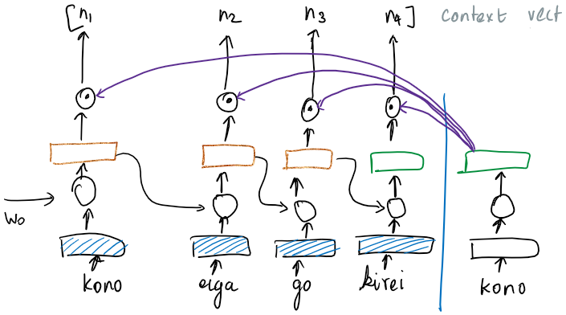
Outline
  Architecture
    Transformer
      Attention
      Multi-head attn
      Masked attn
    BERT
    T5
  C4 corpus
  Comparison study
Self Attention
  Processes a sequence by replacing each element by a weighted average of the rest of the sequence
2

Slide 13
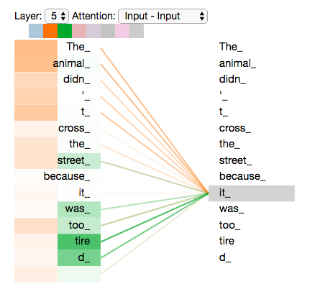
Outline
  Architecture
    Transformer
      Attention
      Multi-head attn
      Masked attn
    BERT
    T5
  C4 corpus
  Comparison study
Multi head attention
Focusses on different blocks of text
[The illustrated transformer http://jalammar.github.io/illustrated-transformer/]
2

Slide 14
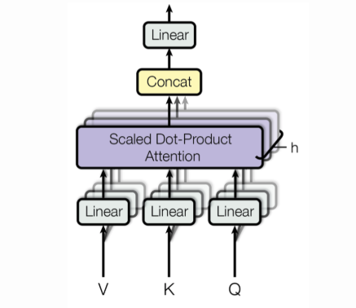
Outline
  Architecture
    Transformer
      Attention
      Multi-head attn
      Masked attn
    BERT
    T5
  C4 corpus
  Comparison study
Multi head attention
Parallelized
[Attention is all you need by Vaswani et al]
14

Slide 15
Outline
  Architecture
    Transformer
      Attention
      Multi-head attn
      Masked attn
    BERT
    T5
  C4 corpus
  Comparison study
Masked attention blocks
Mask vector to ensure terms attend only to itself and previous timestep terms.
14

Slide 16
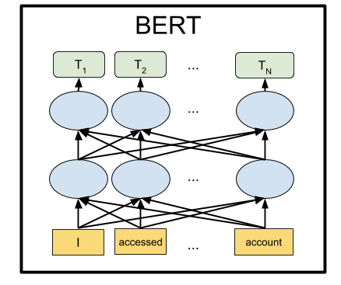
Outline
  Architecture
    Transformer
    BERT
    T5
  C4 corpus
  Comparison study
BERT
Bidirectional Encoder Representations from Transformers
Encoder-only architecture
Fully connected masking
Denoising pre-training
objective
[BERT: Pre-training of Deep Bidirectional Transformers for Language Understanding by devlin et al. 2018]
16

Slide 17
Outline
  Architecture
    Transformer
    BERT
    T5
  C4 corpus
  Comparison study
BERT
Bidirectional Encoder Representations from Transformers
BERT-BASE
    Layers=12
    Hidden size=768
    Attention head=12
    Total Parameters=110M
BERT-LARGE
    Layers=24
    Hidden size=1024
    Attention head=16
    Total Parameters=340M
16

Slide 18

Outline
  Architecture
    Transformer
    BERT
    T5
  C4 corpus
  Comparison study
Our model – Text-to-Text Transfer Transformer (T5)
Every task is modelled in text-to-text format – takes input as text (prefixed with task objective) and produces output as text
16

Slide 19
Outline
  Architecture
    Transformer
    BERT
    T5
  C4 corpus
  Comparison study
Baseline
The proposed baseline is similar to transformer architecture except changes in:
  Layer Normalization : No bias
Placed outside residual connection
  Relative positional encoding
  Word piece embedding
16
Notes:
Dropouts in feedforward layer
Relative positional encoding:
Will add here
Word piece embeddings:
<number>

Slide 20
Outline
  Architecture
    Transformer
    BERT
    T5
  C4 corpus
  Comparison study
Baseline - configuration
12 – Encoder-decoder (each) blocks
3072 – dimensionality of feed forward layer
12 – attention head
64 – dimensions of Key, value matrix
0.1 – dropout probability
220 million parameters
19
Notes:
Dropouts in feedforward layer
Relative positional encoding:
Will add here
Word piece embeddings:
<number>

Slide 21
Colossal common crawled corpus
Pre-training dataset
20

Slide 22
Outline
  Architecture
  C4 corpus
  Analysis
Common crawled corpus
Web crawl data
Preprocessing
  Remove sentences containing offensive language
  Discard sentences < length of 5
  Remove sentences containing code
  Remove other language text except English
750GB
20
Notes:
<number>

Slide 23
A Systematic Study of Transfer Learning Methodology
Comparison of different methods and objectives in transfer learning
23

Slide 24
Outline
  Architecture
  C4 corpus
  Analysis
Tasks Considered
The comparative study was performed on
Glove
CNN-DM
SQUAD
SuperGLUE
WMT
23

Slide 25
Outline
  Architecture
  C4 corpus
  Analysis
    Objective
    Dataset
    Multi-task
    Scaling
Architecture
Encoder, decoder transformer – Causal masking
BERT – Fully connected masking (bidirectional)
Prefix LM – Prefix masking
25

Slide 26
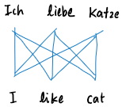
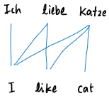
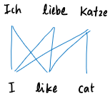
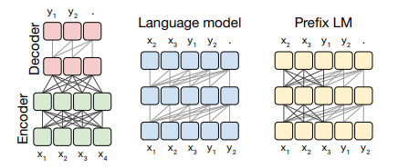
Outline
  Architecture
  C4 corpus
  Analysis
    Objective
    Dataset
    Multi-task
    Scaling
Architecture
Fully connected
Causal
Prefix causal
25

Slide 27
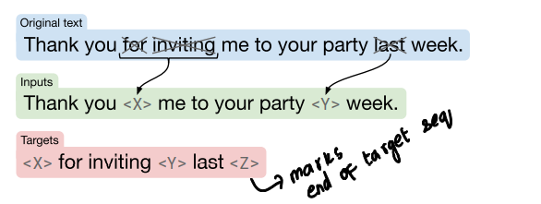
Outline
  Architecture
  C4 corpus
  Analysis
    Objective
    Dataset
    Multi-task
    Scaling
Pre-training Objective
Denoising – BERT style
Sequence prediction – LM style
De-shuffling
27
Notes:
BERT objective
Replaces 15% of tokens – 90% by <M> , 10% replaced by random token
LM style :
Sequence prediction
De-shuffling:
Interchange the corrupted tokens. The output is the correctly ordered token.
Output: correct sentence
Size is compared in terms of Number of layers, number of params and computation cost
<number>

Slide 28
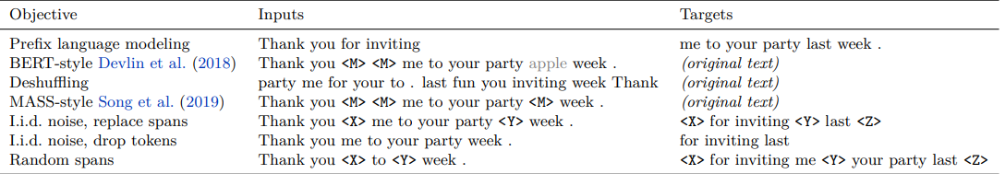
Outline
  Architecture
  C4 corpus
  Analysis
    Objective
    Dataset
    Multi-task
    Scaling
Pre-training Objective
Variants of BERT objective
MASS style
Span based
Corruption rate
Span length
28
Notes:
MASS style
15% tokens corrupted by replacing with <M>
Span based:
Replace contiguous span by <M> instead of replacing each token.
Faster because we do not have to reconstruct the entire sentence. As that requires self attention on the entire sentence
Drop spans:
The corrupted spans are simply removed. The output are the spans that were removed.
<number>

Slide 29
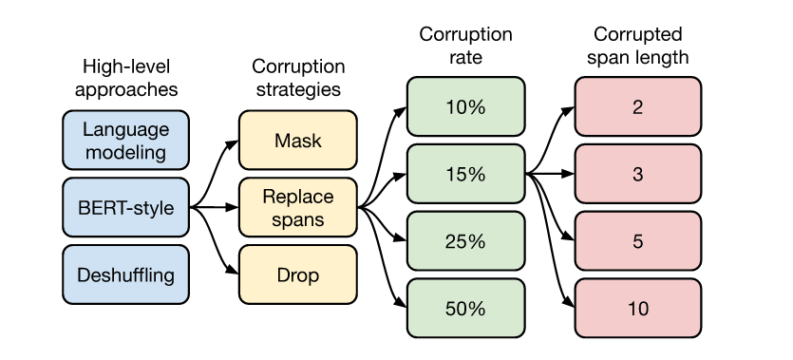
Outline
  Architecture
  C4 corpus
  Analysis
    Objective
    Dataset
    Multi-task
    Scaling
Pre-training objective
28
Notes:
<number>

Slide 30
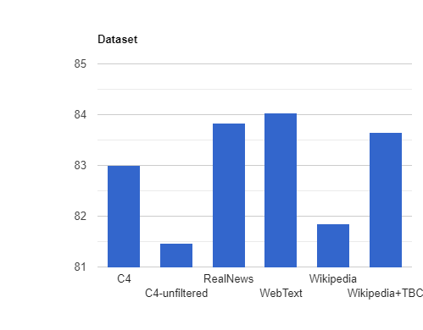
Outline
  Architecture
  C4 corpus
  Analysis
    Objective
    Dataset
    Multi-task
    Scaling
Pre-training Dataset
Web text / real news gives better score GLUE tasks
Wikipedia + TBC produces good performance on Super Glue task
Because of MULTIRC task in glue/superglue comes from similar domain
Wikipedia gains on SQUAD for similar reasons
Pre-training on in-domain unlabeled data can improve performance on downstream tasks
30
Notes:
<number>

Slide 31
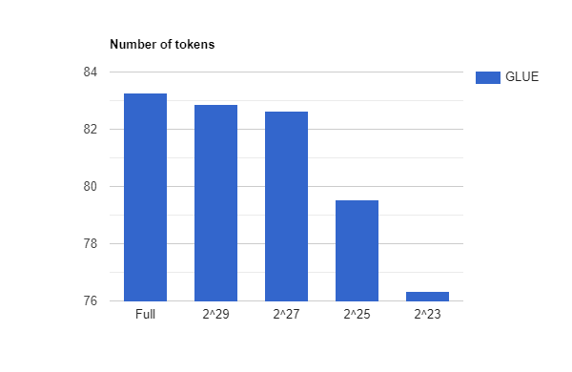
Outline
  Architecture
  C4 corpus
  Analysis
    Objective
    Dataset
    Multi-task
    Scaling
Pre-training Dataset Size
Full dataset size is 2^35
30
Notes:
Dataset size
Decreasing dataset size repeats the tokens – overfitting to training data
Fine tuning:
Small d Adapter layer works well on low resource (task that require less training data to achieve good performance) like SQUAD.
Gradual unfreezing – little less performance buts speeds up training
<number>

Slide 32
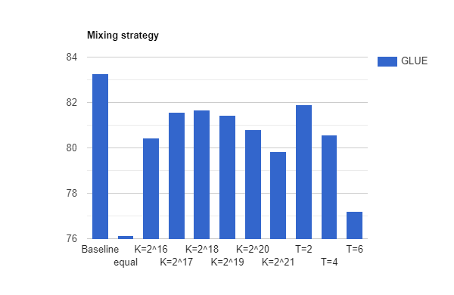
Outline
  Architecture
  C4 corpus
  Analysis
    Objective
    Dataset
    Multi-task
    Scaling
Multi task learning
Mixing dataset of multiple task (in T5 model)
Examples proportional
  Sample proportional to dataset size setting limit for larger models
Temperature scaled
  Raise the mixing rate by power of 1/T.
  Value of T determines how much larger dataset is mixed.
32
Notes:
Training the model on multiple task
Example proportional:
Even if taken propotionally, some dataset are very big, denoising task, En-French ..etc. This will hamper the ability of the model to perform well on all task
Temperature scaled. T=1 = example proportion
WMT has bad performance on both setup because it is a high resource task. So large dataset has to be included completely or majorly.
<number>

Slide 33
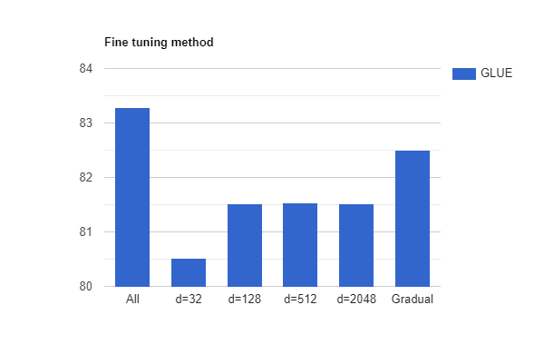
Outline
  Architecture
  C4 corpus
  Analysis
    Objective
    Dataset
    Multi-task
    Scaling
Downstream Fine tuning
Adapter layer:
  Dense-Relu layer after each feedforward layer.
  d- dimensionality of above dense layer.
Gradual unfreezing
  Fine tuning from bottom to top layer in steps.
32
Notes:
Dataset size
Decreasing dataset size repeats the tokens – overfitting to training data
Fine tuning:
Small d Adapter layer works well on low resource (task that require less training data to achieve good performance) like SQUAD.
Gradual unfreezing – little less performance buts speeds up training
<number>

Slide 34
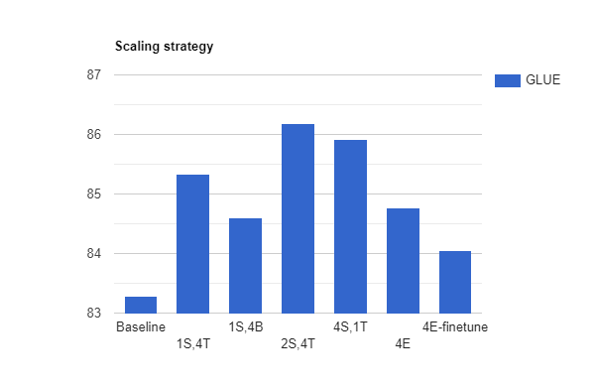
Outline
  Architecture
  C4 corpus
  Analysis
    Objective
    Dataset
    Multi-task
    Scaling
Scaling
With 4X more computing power
Larger size model:
  Similar to BERT large model
  4096 feedforward dimension
  16 attention head
  16, 32 layers encoder-decoder block
T5 - 3B params:
  16384 – feedforward layer dimension
  32 attention head
T5 – 11B params:
  65538 – feedforward layer dimension
33
Notes:
Increase in feedforward layer dimension because it is easy to parallelize. Similarly for attention head.
<number>

Slide 35
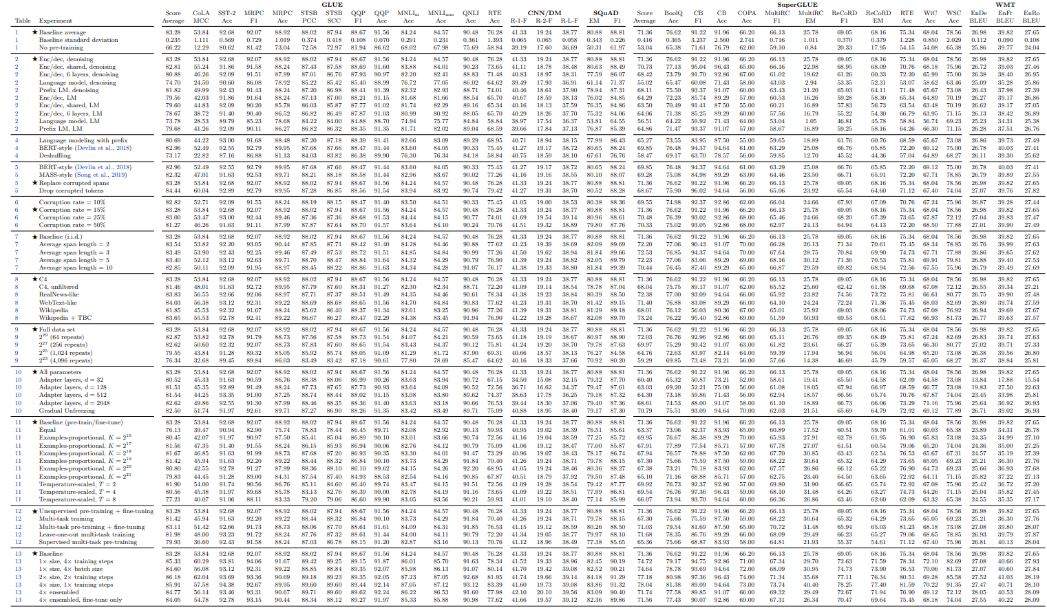
34

Slide 36
Outline
  Architecture
  C4 corpus
  Analysis
Final model
Objective | Replacing 15% corrupted span of length 3
Dataset | C4
Model size | Small(60M) ,baseline(220M), large(770M), 3B , 11B
Multi task pretraining | MT-DNN
Fine tuning | On Glove and Super glove, smaller batch size
34

Slide 37
Outline
  Architecture
  C4 corpus
  Analysis
Possible Improvements
Not language agnostic
Architecture similar to BERT
Balance between computational cost and performance for practical setting.
<number>

Slide 38
Summary
Model architecture of Transformer, BERT and T5 baseline architecture
C4 pre-training dataset
Comparison of different transfer learning techniques and methodologies
The Final State of the art T5 model
Thank You!
<number>

Slide 39
Thank you
<number>

